Slide 1
Data Mining

Slide 2
Introduction
Motivation: Why data mining?
What is data mining?
Data mining functionality
Data Mining Process
Classification of data mining systems
Major issues in data mining

Slide 3
Why Data Mining?
The Explosive Growth of Data: from terabytes to petabytes
  Data collection and data availability
    Automated data collection tools, database systems, Web, computerized society
  Major sources of abundant data
    Business: Web, e-commerce, transactions, stocks, …
    Science: Remote sensing, bioinformatics, scientific simulation, …
    Society and everyone: news, digital cameras, YouTube
We are drowning in data, but starving for knowledge!
“Necessity is the mother of invention”—Data mining—Automated analysis of massive data sets

Slide 4


What Is Data Mining?
Data mining (knowledge discovery from data)
  Extraction of interesting (non-trivial, implicit, previously unknown and potentially useful) patterns or knowledge from huge amount of data
Alternative names
  Knowledge discovery (mining) in databases (KDD), knowledge extraction, data/pattern analysis, data archeology, data dredging, information harvesting, business intelligence, etc.

Slide 5
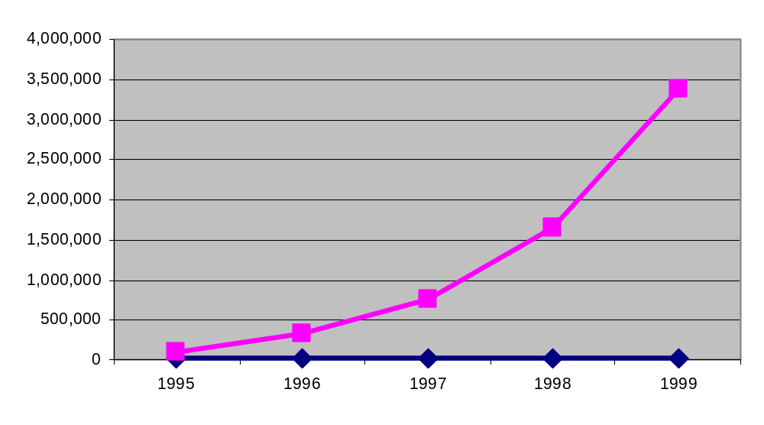
Data Mining
Data mining is the process of automatically discovering useful information in large data repositories.
Human analysts may take weeks to discover useful information.
Much of the data is never analyzed at all.
The Data Gap
Total new disk (TB) since 1995
Number of analysts

Slide 6
What is (not) Data Mining?
What is not Data Mining?
  Look up phone number in phone directory
  Query a Web search engine for information about “Amazon”
What is Data Mining?
  Certain names are more prevalent in certain locations (O’Brien, O’Rurke, O’Reilly… in Boston area)
  Discover groups of similar documents on the Web

Slide 7
Data mining
The overall goal of the data mining process is to extract information from a data set and transform it into an understandable structure for further use.
The key properties of data mining are
  Automatic discovery of patterns
  Prediction of likely outcomes
  Creation of actionable information
  Focus on large datasets and databases

Slide 8
Tasks of Data Mining
Anomaly detection (Outlier/change/deviation detection) –
The identification of unusual data records, that might be interesting or data errors that require further investigation.
Association rule learning (Dependency modelling) –
Searches for relationships between variables. For example a supermarket might gather data on customer purchasing habits. Using association rule learning, the supermarket can determine and find out which products are frequently bought together and use this information for marketing purposes. This is sometimes referred to as market basket analysis.

Slide 9
Tasks of Data Mining
Clustering – is the task of discovering groups and structures in the data that are in some way or another "similar", without using known structures in the data.
Classification – is the task of generalizing known structure to apply to new data. For example, an e-mail program might attempt to classify an e-mail as "legitimate" or as "spam".
Regression – attempts to find a function which models the data with the least error.
Summarization – providing a more compact representation of the data set, including visualization and report generation.

Slide 10
Knowledge Discovery (KDD) Process
Knowledge
  Data mining—core of knowledge discovery process
Pattern Evaluation
Data Mining
Task-relevant Data
Data Warehouse
Selection
Data Cleaning
Data Integration
Databases

Slide 11
KDD Process
KDD (Knowledge Discovery in Databases) is a process that involves the extraction of useful, previously unknown, and potentially valuable information from large datasets.
The KDD process is an iterative process and it requires multiple iterations of the above steps to extract accurate knowledge from the data.
The following steps are included in KDD process:
Data Cleaning
Data cleaning is defined as removal of noisy and irrelevant data from collection.
  Cleaning in case of Missing values.
  Cleaning noisy data, where noise is a random or variance error.
  Cleaning with Data discrepancy detection and Data transformation tools.

Slide 12
KDD Process
Data Integration
  Data integration is defined as heterogeneous data from multiple sources combined in a common source (DataWarehouse). Data integration using Data Migration tools, Data Synchronization tools and ETL(Extract-Load-Transformation) process.
Data Selection
  Data selection is defined as the process where data relevant to the analysis is decided and retrieved from the data collection. For this we can use Neural network, Decision Trees, Naive bayes, Clustering, and Regression methods.

Slide 13
KDD Process
Data Transformation
  Data Transformation is defined as the process of transforming data into appropriate form required by mining procedure. Data Transformation is a two step process:
    Data Mapping: Assigning elements from source base to destination to capture transformations.
    Code generation: Creation of the actual transformation program.
Data Mining
  Data mining is defined as techniques that are applied to extract patterns potentially useful. It transforms task relevant data into patterns, and decides purpose of model using classification or characterization.

Slide 14
KDD Process
Pattern Evaluation
  Pattern Evaluation is defined as identifying strictly increasing patterns representing knowledge based on given measures. It find interestingness score of each pattern, and uses summarization and Visualization to make data understandable by user.
Knowledge Representation
  This involves presenting the results in a way that is meaningful and can be used to make decisions.

Slide 15
Advantages of KDD
Improves decision-making: KDD provides valuable insights and knowledge that can help organizations make better decisions.
Increased efficiency: KDD automates repetitive and time-consuming tasks and makes the data ready for analysis, which saves time and money.
Better customer service: KDD helps organizations gain a better understanding of their customers’ needs and preferences, which can help them provide better customer service.
Fraud detection: KDD can be used to detect fraudulent activities by identifying patterns and anomalies in the data that may indicate fraud.
Predictive modeling: KDD can be used to build predictive models that can forecast future trends and patterns.

Slide 16
Disadvantages of KDD
Privacy concerns: KDD can raise privacy concerns as it involves collecting and analyzing large amounts of data, which can include sensitive information about individuals.
Complexity: KDD can be a complex process that requires specialized skills and knowledge to implement and interpret the results.
Unintended consequences: KDD can lead to unintended consequences, such as bias or discrimination, if the data or models are not properly understood or used.
Data Quality: KDD process heavily depends on the quality of data, if data is not accurate or consistent, the results can be misleading
High cost: KDD can be an expensive process, requiring significant investments in hardware, software, and personnel.
Overfitting: KDD process can lead to overfitting, which is a common problem in machine learning where a model learns the detail and noise in the training data to the extent that it negatively impacts the performance of the model on new unseen data

Slide 17
Data Mining Process
Data Mining is a process of discovering various models, summaries, and derived values from a given collection of data.
1. State the problem and formulate the hypothesis
2. Collect the data
3. Preprocessing the data
4. Estimate the model
5. Interpret the model and draw conclusion

Slide 18
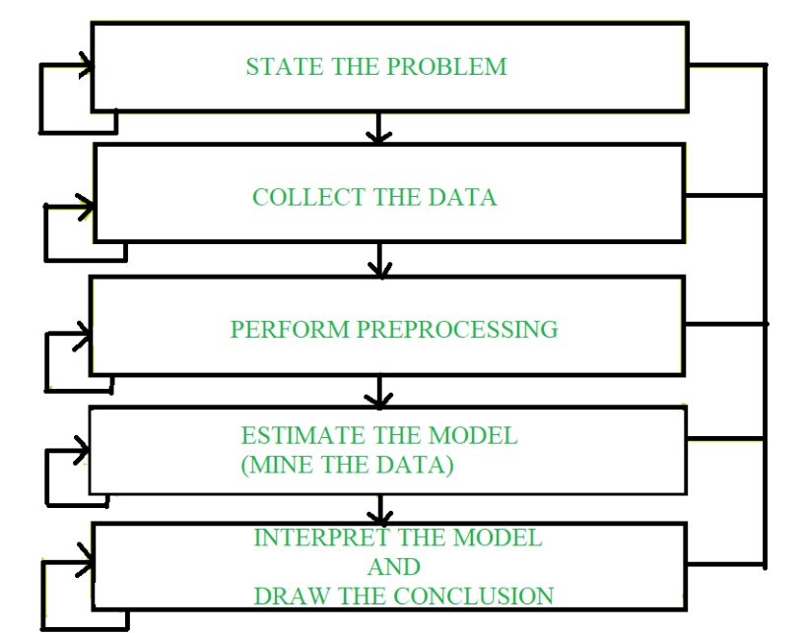
Data Mining Process

Slide 19
Data Mining Process
1. State the problem and formulate the hypothesis
Most data-based modeling studies are performed in a particular application domain.
Domain-specific knowledge and experience are usually necessary for identify meaningful problem statement.
In this step, a modeler usually specifies a set of variables for the unknown dependency and, if possible, a general form of this dependency as an initial hypothesis.
There may be several hypotheses formulated for a single problem at this stage.
Close interaction between the data-mining expert and the application expert is needed for entire entire data-mining process

Slide 20
Data Mining Process
2. Collect the data
This step is concerned with how the data are generated and collected.
There are two distinct possibilities.
The first is when the data-generation process is under the control of an expert (modeler): this approach is known as a designed experiment.
The second possibility is when the expert cannot influence the data-generation process: this is known as the observational approach.
An observational setting, namely, random data generation, is assumed in most data-mining applications.
Typically, the sampling distribution is completely unknown after data are collected, or it is partially and implicitly given in the data-collection procedure.

Slide 21
Data Mining Process
2. Collect the data
Also, it is important to make sure that the data used for estimating a model and the data used later for testing and applying a model come from the same, unknown, sampling distribution.
If this is not the case, the estimated model cannot be successfully used in a final application of the results.

Slide 22
Data Mining Process
3. Preprocessing the data
Data preprocessing usually includes at least two common tasks:
Outlier detection (and removal)
Scaling, encoding, and selecting features
Outlier detection (and removal) –
Outliers are unusual data values that are not consistent with most observations.
Commonly, outliers result from measurement errors, coding and recording errors, and, sometimes, are natural, abnormal values.
Such non representative samples can seriously affect the model produced later.
There are two strategies for dealing with outliers:
  Detect and eventually remove outliers as a part of the preprocessing phase, or
  Develop robust modeling methods that are insensitive to outliers.

Slide 23
Data Mining Process
2. Scaling, encoding, and selecting features –
Data preprocessing includes several steps such as variable scaling and different types of encoding.
For example, one feature with the range [0, 1] and the other with the range [−100, 1000] will not have the same weights in the applied technique; they will also influence the final data-mining results differently.
Therefore, it is recommended to scale them and bring both features to the same weight for further analysis.
Also, application-specific encoding methods usually achieve dimensionality reduction by providing a smaller number of informative features for subsequent data modeling.

Slide 24
Data Mining Process
4. Estimate the model
The selection and implementation of the appropriate data-mining technique is the main task in this phase.
  This process is not straightforward; usually, in practice, the implementation is based on several models, and selecting the best one is an additional task.
5.Interpret the model and draw conclusion
  Data-mining models are used for decision making.
  Hence, such models need to be interpretable in order to be useful because humans are not likely to base their decisions on complex "black-box" models.
  Note that the goals of accuracy of the model and accuracy of its interpretation are somewhat contradictory.

Slide 25
Data Mining Process
5.Interpret the model and draw conclusion
Usually, simple models are more interpretable, but they are also less accurate.
Modern data-mining methods are expected to yield highly accurate results using high dimensional models.
The problem of interpreting these models, also very important, is considered a separate task, with specific techniques to validate the results.
A user does not want hundreds of pages of numeric results. He does not understand them; he cannot summarize, interpret, and use them for successful decision making.

Slide 26
Data Mining: Confluence of Multiple Disciplines
Database
Technology
Statistics
Machine
Learning
Data Mining
Visualization
Pattern
Recognition
Other
Disciplines
Algorithm

Slide 27
Classification of Data Mining Systems
The data mining system can be classified according to the following criteria:
Database Technology
Statistics
Machine Learning
Information Science
Visualization
Other Discipline

Slide 28
Classification of Data Mining Systems
Some Other Classification Criteria:
Classification according to kind of databases mined
Classification according to kind of knowledge mined
Classification according to kinds of techniques utilized
Classification according to applications adapted

Slide 29
Classification of Data Mining Systems
Classification according to kind of databases mined
A data mining system can be classified based on the types of databases that have been mined.
A database system can be further segmented based on distinct principles, such as data models, types of data, etc., which further assist in classifying a data mining system.
For example, if we want to classify a database based on the data model, we need to select either relational, transactional, object-relational or data warehouse mining systems.

Slide 30
Classification of Data Mining Systems
A data mining system categorized based on the kind of knowledge mind may have the following functionalities:
Characterization
Discrimination
Association and Correlation Analysis
Classification
Prediction
Outlier Analysis
Evolution Analysis

Slide 31
Classification of Data Mining Systems
Classification according to kinds of techniques utilized:
This technique involves the degree of user interaction or the technique of data analysis involved.
For example, machine learning, visualization, pattern recognition, neural networks, database-oriented or data-warehouse oriented techniques.

Slide 32
Classification of Data Mining Systems
Classification according to applications adapted
Finance
Telecommunications
DNA
Stock Markets
E-mail

Slide 33
Major Issues In Data Mining
Mining different kinds of knowledge from diverse data types, e.g., bio, stream, Web
Performance: efficiency, effectiveness, and scalability
Pattern evaluation: the interestingness problem
Incorporation of background knowledge
Handling noise and incomplete data
Parallel, distributed and incremental mining methods
Integration of the discovered knowledge with existing one: knowledge fusion
User interaction

Slide 34
Major Issues In Data Mining
Mining different kinds of knowledge in databases. –
The need of different users is not the same. And Different user may be in interested in different kind of knowledge.
Therefore it is necessary for data mining to cover broad range of knowledge discovery task.
Interactive mining of knowledge at multiple levels of abstraction. The data mining process needs to be interactive because it allows users to focus the search for patterns, providing and refining data mining requests based on returned results.

Slide 35
Major Issues In Data Mining
Incorporation of background knowledge.
To guide discovery process and to express the discovered patterns, the background knowledge can be used. Background knowledge may be
used to express the discovered patterns not only in concise terms but at multiple level of abstraction.
Data mining query languages and ad hoc data mining.
Data Mining Query language that allows the user to describe ad hoc mining tasks, should be integrated with a data warehouse query language and optimized for efficient and flexible data mining.

Slide 36
Major Issues In Data Mining
Pattern evaluation.
It refers to interestingness of the problem. The patterns discovered should be interesting because either they represent common knowledge or lack novelty.
Efficiency and scalability of data mining algorithms.
In order to effectively extract the information from huge amount of data in databases, data mining algorithm must be efficient and scalable.

Slide 37
Major Issues In Data Mining
Parallel, distributed, and incremental mining algorithms. - The factors such as huge size of databases, wide distribution of data and complexity of data mining methods motivate the
development of parallel and distributed data mining algorithms.
These algorithm divide the data into partitions which is further processed parallel. Then the results from the partitions is merged.
The incremental algorithms, updates databases without having mine the data again from scratch

Slide 38
Major Issues In Data Mining
Presentation and visualization of data mining results.
Once the patterns are discovered it needs to be expressed in high level languages, visual representations. This representations should
be easily understandable by the users.
Handling noisy or incomplete data.
The data cleaning methods are required that can handle the noise, incomplete objects while mining the data regularities. If data cleaning methods are not there then the accuracy of the discovered patterns will be poor.

